Slide 1
DRUGS, SIDE EFFECTS AND MEDICAL CONDITIONS
By
Madhumita patross

Slide 2
STARTING NOTES
Project Title - Drugs, Side Effects and Medical Condition
Tools - Python, ML, SQL, Excel

Slide 3
ABOUT DATA FOR THE PROJECT
Data contains details of various drugs (used for conditions like Acne, Cancer, Heart Disease, etc. ) and their side effects
generic_name: The chemical name of the drug (not brand name)
drug_classes:
  The drug belongs to which drug class, i.e a drug class is a set of medications
  and other compounds that have a similar chemical structure, the same
  mechanism of action (i.e. binding to the same biological target), a related mode
  of action, and/or are used to treat the same disease.

Slide 4
ABOUT DATA FOR THE PROJECT
brand_names: brand names in which the drugs are being sold or available in the market.
activity:
Activity is based on recent site visitor activity relative to other medications in the list.
Data was gathered from https://www.drugs.com
rx_otc:
Rx-to-OTC switch is the transfer of proven prescription drugs to
nonprescription

Slide 5
ABOUT DATA FOR THE PROJECT
OTC (Over-the-counter) = Medication that can be purchased without a medical prescription
Rx = Prescription Needed
Rx/OTC = Prescription or Over-the-counter

Slide 6
ABOUT DATA FOR THE PROJECT
pregnancy_category:
  A = Adequate and well-controlled studies have failed to demonstrate a risk to the fetus in the first trimester of pregnancy (and there is no evidence of risk in later trimesters).
  B = Animal reproduction studies have failed to demonstrate a risk to the fetus and there are no adequate and well-controlled studies in pregnant women.
  C = Animal reproduction studies have shown an adverse effect on the fetus and
  there are no adequate and well-controlled studies in humans, but potential
  benefits may warrant use in pregnant women despite potential risks

Slide 7
PREGNANCY_CATEGORY
D = There is positive evidence of human fetal risk based on adverse reaction data from investigational or marketing experience or studies in humans, but potential benefits may warrant use in pregnant women despite potential risks
X = Studies in animals or humans have demonstrated fetal abnormalities and/or
there is positive evidence of human fetal risk based on adverse reaction data
from investigational or marketing experience, and the risks involved in use in
pregnant women clearly outweigh potential benefits

Slide 8
PREGNANCY_CATEGORY
N = FDA has not classified the drug
csa: Controlled Substances Act (CSA) Schedule
M = The drug has multiple schedules. The schedule may depend on the exact dosage form or strength of the medication
U = CSA Schedule is unknown
N = Is not subject to the Controlled Substances Act

Slide 9
PREGNANCY_CATEGORY
1 = Has a high potential for abuse. Has no currently accepted medical use in treatment in the United States. There is a lack of accepted safety for use under medical supervision
2 = Has a high potential for abuse. Has a currently accepted medical use in
treatment in the United States or a currently accepted medical use with severe
restrictions. Abuse may lead to severe psychological or physical dependence

Slide 10
PREGNANCY_CATEGORY
3 = Has a potential for abuse less than those in schedules 1 and 2. Has a
currently accepted medical use in treatment in the United States. Abuse may lead to moderate or low physical dependence or high psychological dependence
4 = Has a low potential for abuse relative to those in schedule 3. It has a
currently accepted medical use in treatment in the United States. Abuse may
lead to limited physical dependence or psychological dependence relative to
those in schedule 3

Slide 11
PREGNANCY CATEGORY
5 = Has a low potential for abuse relative to those in schedule 4. Has a currently accepted medical use in treatment in the United States. Abuse may lead to limited physical dependence or psychological dependence relative to those in schedule 4
alcohol:
X = Interacts with Alcohol.
rating:
For ratings, users were asked how effective they found the medicine while
considering positive/adverse effects and ease of use (1 = not effective, 10 = most
effective)

Slide 12
Exploratory Data Analysis on Drugs, Side Effects, and Medical Conditions
1. Objective
The goal is to analyze the relationships between drugs, their side effects, and the medical conditions they treat, as well as to explore the ratings and reviews associated with these drugs
Tools Required
● Python: The primary programming language for data analysis.
● Pandas: For data manipulation and analysis.
● Matplotlib/Seaborn: For data visualization.
● Jupyter Notebook: To write and run Python code.

Slide 13
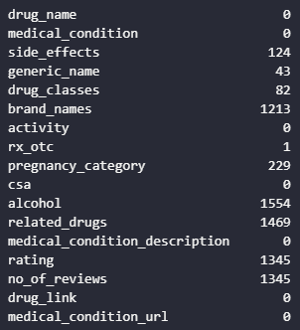
PROJECT_STEP 1 - Check for missing values

Slide 14
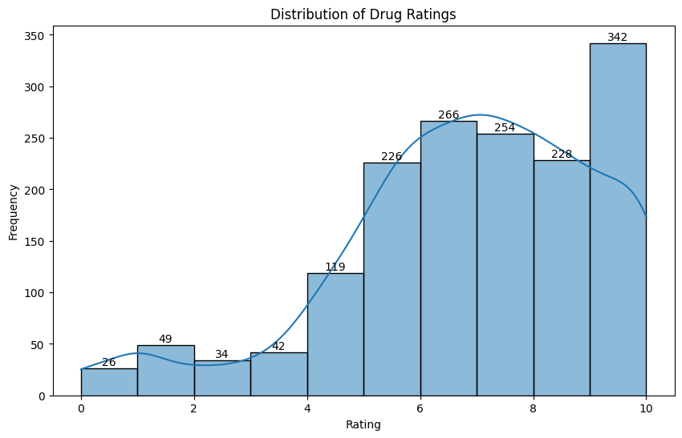
Distribution of drug ratings

Slide 15
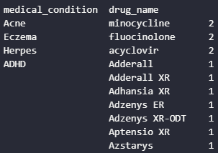
Analyzing Relationships - Top Drugs by Condition

Slide 16
Side Effects Analysis
Name: count, dtype: int64 side_effects hives ; difficult breathing; swelling of your face, lips, tongue, or throat. This medicine may cause serious side effects. Stop using this medicine and call your doctor at once if you have: redness or swelling of the treated area; increased pain; or severe burning or skin irritation such as a rash, itching, pain, or blistering. Less serious side effects may be more likely, and you may have none at all. 10 hives ; difficult breathing; swelling of your face, lips, tongue, or throat. This medicine may cause serious side effects. Stop using this medicine and call your doctor at once if you have: bone pain, muscle weakness; confusion, changes in your mental state, seizure (convulsions); or pale skin, feeling light-headed or short of breath, rapid heart rate. Less serious side effects may be more likely, and you may have none at all. 8 redness, warmth, swelling, itching, stinging, burning, or irritation of treated skin. 7 hives ; difficult breathing; swelling of your face, lips, tongue, or throat. Less serious side effects may include: stinging; rash; or skin irritation. 5 hives ; difficulty breathing; swelling of your face, lips, tongue, or throat. This medicine may cause serious side effects. Stop using this medicine and call your doctor at once if you have: nervousness , dizziness , or sleeplessness ; chest pain, fast or uneven heart rate; little or no urinating; dangerously high blood pressure (severe headache , buzzing in your ears, anxiety , shortness of breath); if your symptoms do not improve after 7 days of treatment, or if you have a fever; or if new symptoms occur. Less serious side effects may be more likely, and you may have none at all. 5 hives ; difficult breathing; swelling of your face, lips, tongue, or throat. Common side effects may include temporary hair loss (especially in children). 5 hives ; difficulty breathing; swelling of your face, lips, tongue, or throat. Less serious side effects may occur, and you may have none at all. 3 hives ; difficult breathing; swelling of your face, lips, tongue, or throat. Less serious side effects may be more likely, and you may have none at all. 3 hives ; difficult breathing; swelling of your face, lips, tongue, or throat. 3 hives ; difficulty breathing; swelling of your face, lips, tongue, or throat. Wash the skin and get medical attention right away if you have severe burning, pain, swelling, or blistering of the skin where you applied this medicine. This medicine may cause serious side effects. Stop using this medicine and call your doctor at once if you have: pale skin, blue-colored lips; headache , confusion; or rapid heartbeats. Common side effects may include a mild burning sensation that can last for several hours or days, especially after your first use of this medicine. 3

Slide 17
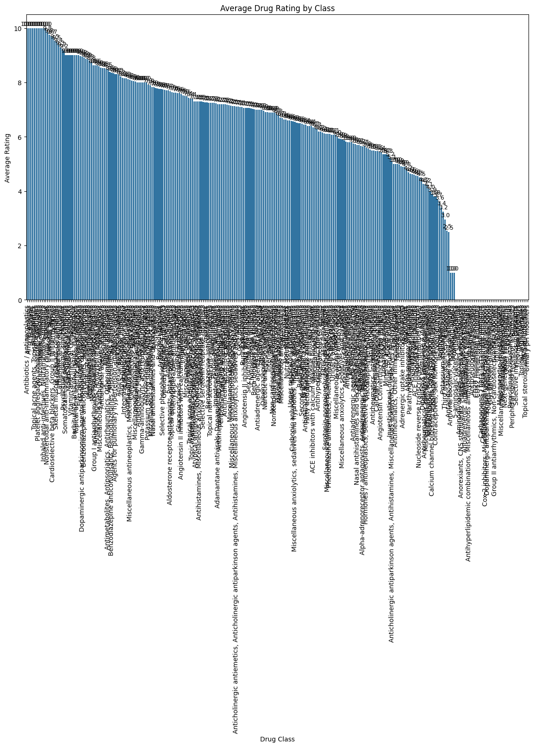
Drug Ratings by Class

Slide 18
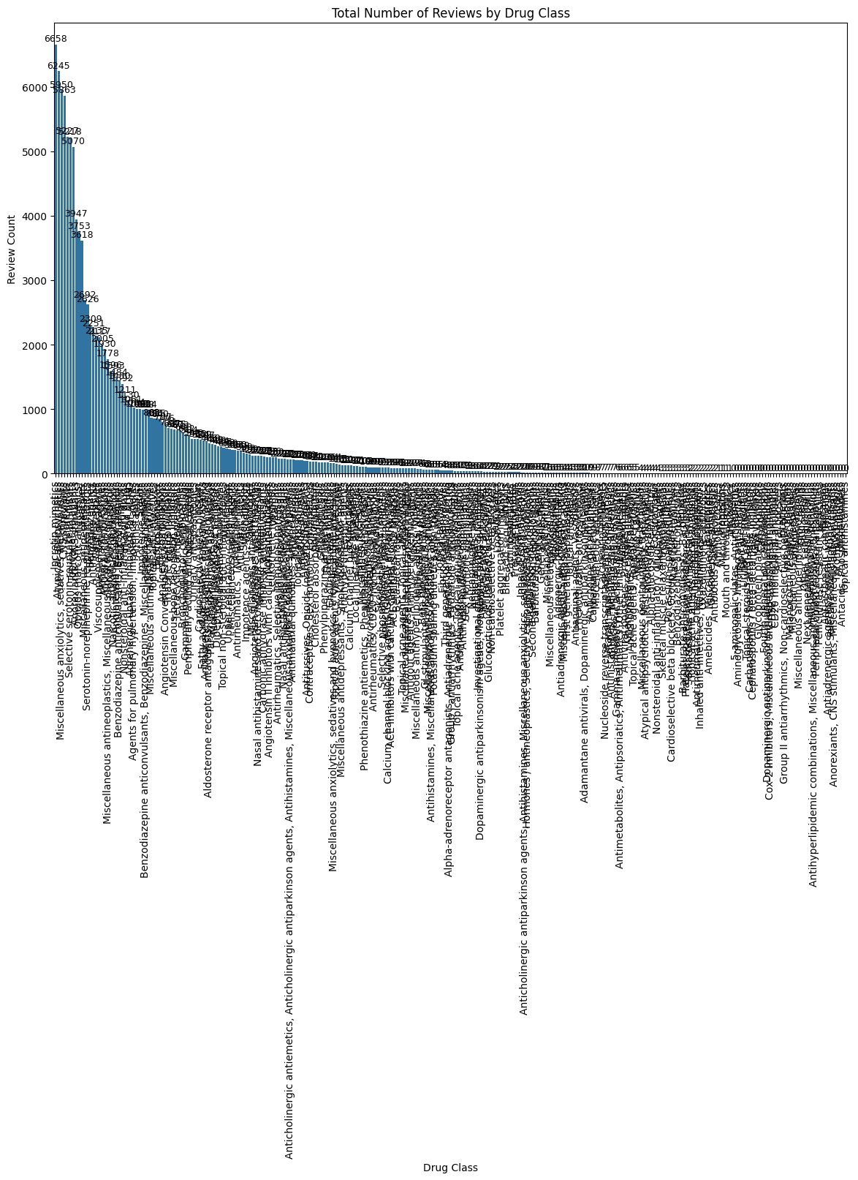
COUNT OF REVIEWS PER DRUG CLASS

Slide 19
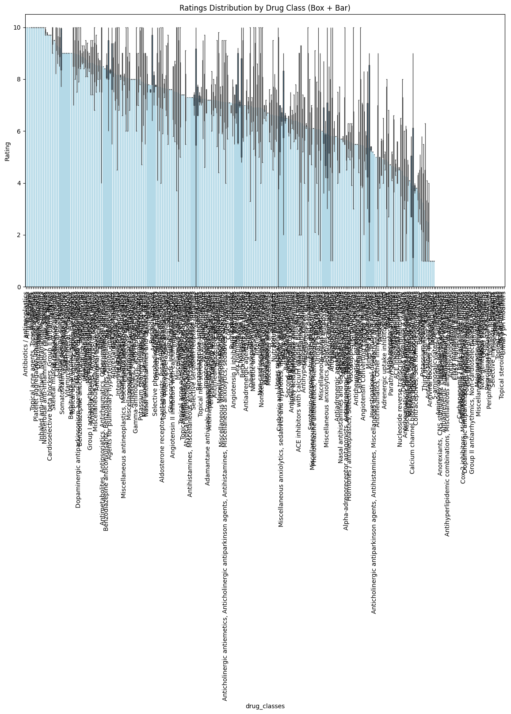
RATINGS BY CLASS

Slide 20
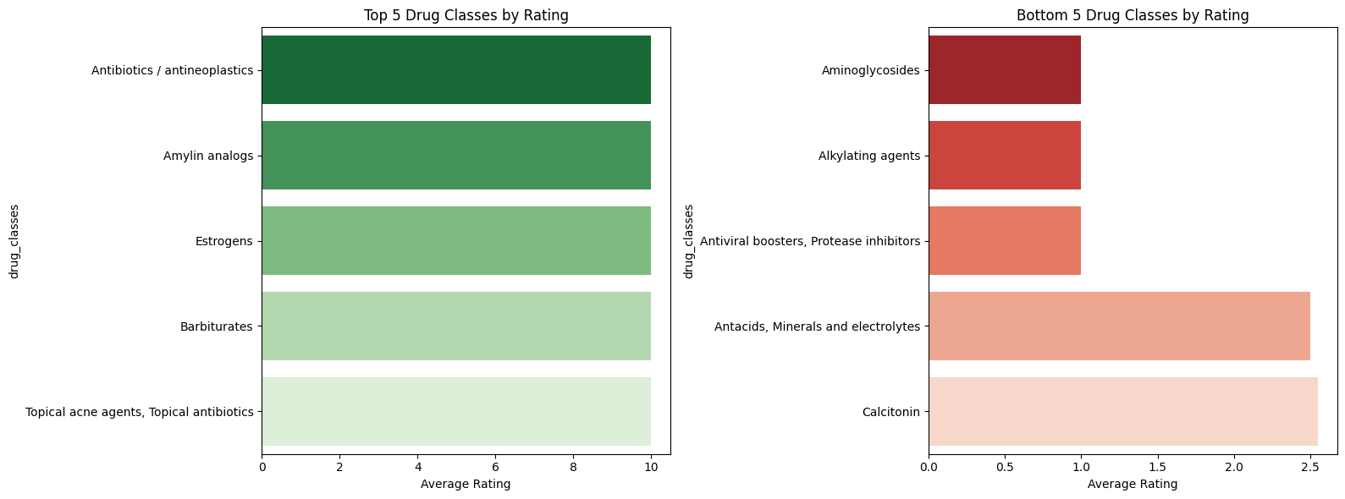
TOP 5 AND BOTTOM 5 DRUGS AS PER RATINGS

Slide 21
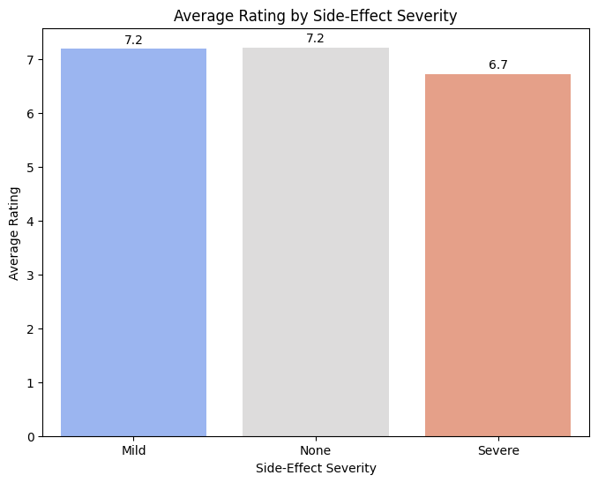
SIDE EFFECT – SENTIMENT VS RATING

Slide 22
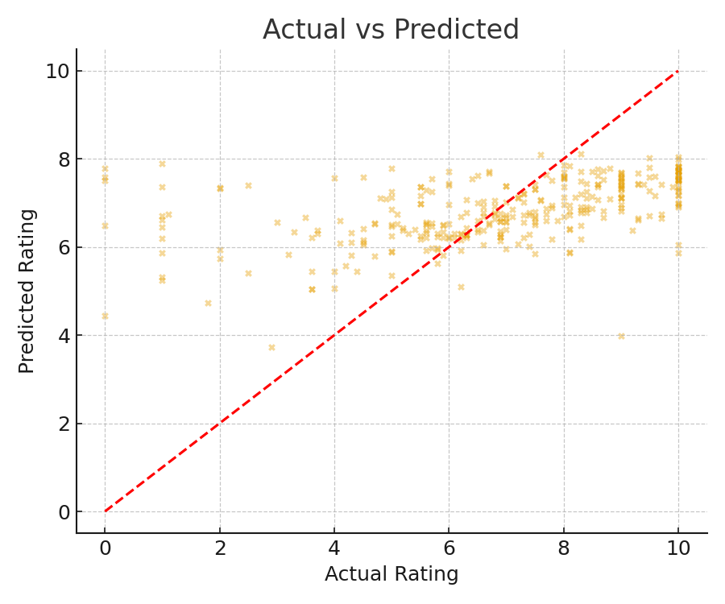
ACTUAL Vs projected rating

Slide 23

Statistical metrics

Slide 24
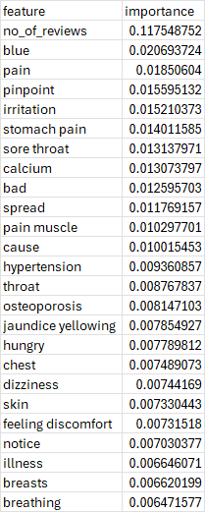
Top features

Slide 25
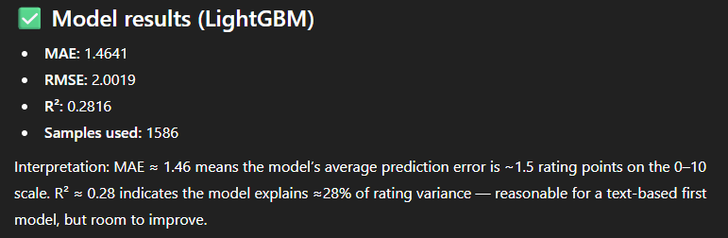
Machine learning analysis with lightgbm

Slide 26
Predicted rating: 7.422779624301415
c:\Users\kkhus\AppData\Local\Programs\Python\Python313\Lib\site-packages\sklearn\base.py:442: InconsistentVersionWarning: Trying to unpickle estimator TfidfTransformer from version 1.1.3 when using version 1.7.2. This might lead to breaking code or invalid results. Use at your own risk. For more info please refer to: https://scikit-learn.org/stable/model_persistence.html#security-maintainability-limitations warnings.warn( c:\Users\kkhus\AppData\Local\Programs\Python\Python313\Lib\site-packages\sklearn\base.py:442: InconsistentVersionWarning: Trying to unpickle estimator TfidfVectorizer from version 1.1.3 when using version 1.7.2. This might lead to breaking code or invalid results. Use at your own risk. For more info please refer to: https://scikit-learn.org/stable/model_persistence.html#security-maintainability-limitations warnings.warn( c:\Users\kkhus\AppData\Local\Programs\Python\Python313\Lib\site-packages\sklearn\base.py:442: InconsistentVersionWarning: Trying to unpickle estimator StandardScaler from version 1.1.3 when using version 1.7.2. This might lead to breaking code or invalid results. Use at your own risk. For more info please refer to: https://scikit-learn.org/stable/model_persistence.html#security-maintainability-limitations warnings.warn( c:\Users\kkhus\AppData\Local\Programs\Python\Python313\Lib\site-packages\sklearn\utils\validation.py:2749: UserWarning: X does not have valid feature names, but LGBMRegressor was fitted with feature names warnings.warn( c:\Users\kkhus\AppData\Local\Programs\Python\Python313\Lib\site-packages\lightgbm\basic.py:1238: UserWarning: Converting data to scipy sparse matrix. _log_warning("Converting data to scipy sparse matrix.")s

Slide 27
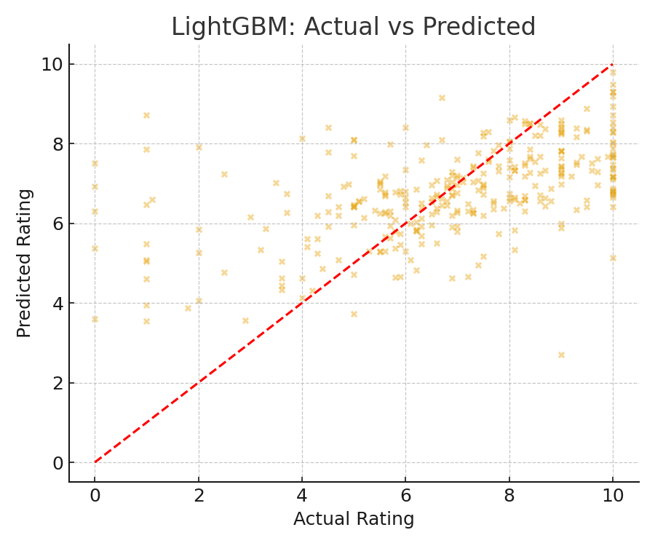
LightGBM: actual VS predicted rating

Slide 28
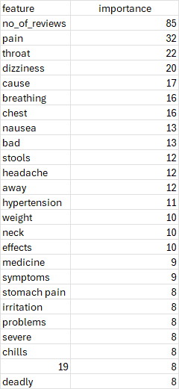
Lightgbm top features

Slide 29
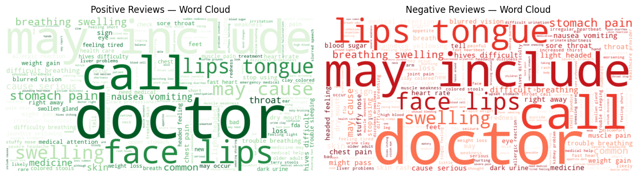
Positive and negative reviews-wordcloud in python

Slide 30
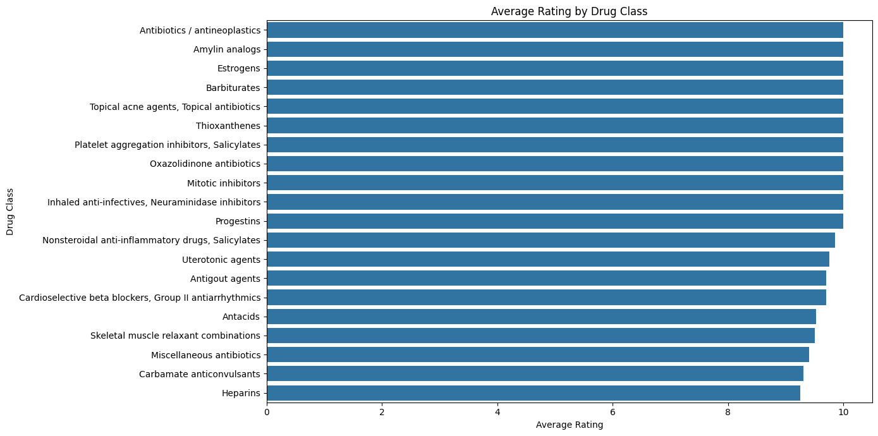

Slide 31
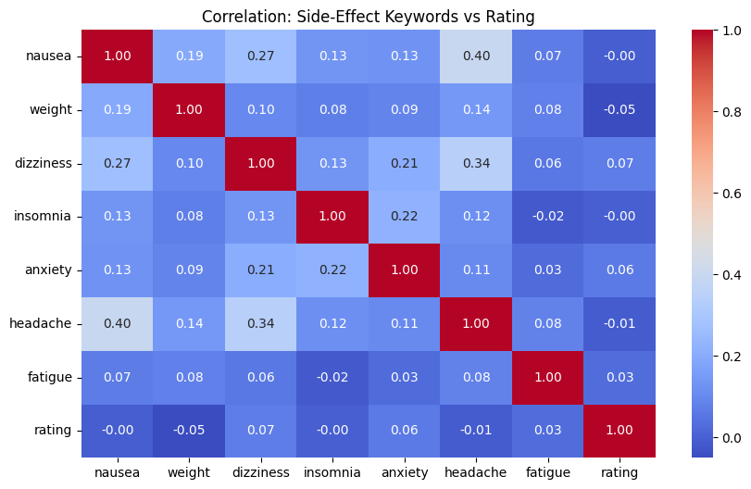

Slide 32
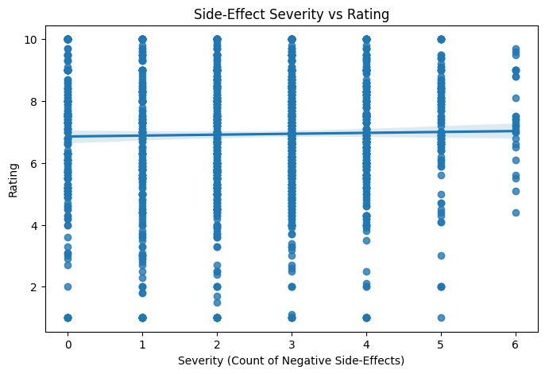

Slide 33
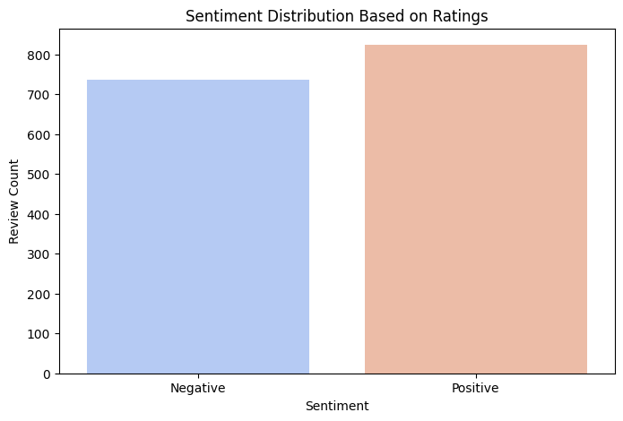
s

Slide 34
Summary of analysis
I have used Machine learning language, Python for the analysis.
In ML – I have used feature LIGHTGBMs

